Slide 1
PBIS in the Classroom
Maggie Schulze Ph.D., BCBA-D
www.soundsupportsk12.com

Slide 2
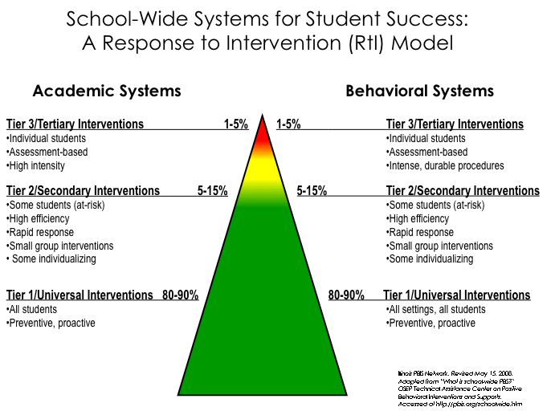
Notes:
2

Slide 3
Classroom Rules/Expectations
Directly connected to schoolwide expectations.
Before you develop rules, consider the misbehaviors you think will most likely occur. How can you prevent them? What do you want instead?
Consider grade level and development.
Who will have input into your rules/expectations?
Are they all “do” statements?
Are they measureable and observable?

Slide 5

Routines & Procedures
Consistently implemented
Teach needed behaviors
Practiced and reinforced
Series of steps taught explicitly
Posted clearly
“Do” statements

Slide 6
Turning in Work
Point of Order/Attention Signal
Arrival/Dismissal
Voice Levels
Distributing Materials
Tasks/Work Completed Early
Asking for Help
Catching Up from an Absence
Transitions
Responding to Behavioral Corrections
Working in Teams or Groups
Sample Key Classroom Routines and Procedures

Slide 9
State, teach, review & reinforce positively stated expectations
Establish behavioral expectations/rules with students. Phrased positively, clearly, objectively.
Teach rules in context of routines and activities and link them to your principles/values.
Prompt or remind students of rule prior to applicable situations. “Remember in the lab safety is first. Please use safety glasses and carefully follow directions…”
Monitor student behavior in & provide specific feedback (corrective or positive praise/feedback).
Evaluate effect of instruction - review data, make decisions, & follow up. Do I need to make adjustments or reteach anything?

Slide 10
Classroom Expectations Discussion
How does having clear and transparent expectations affect classroom and school climate?
Would creating a classroom behavior matrix be a useful exercise for your classroom?
How could you involve students in developing these?

Slide 11
Frequent & Varied
Opportunities to Respond (OTR)
& Feedback
Positive Effects at 3 OTR Per Minute.
Group OTR and Positive Teacher/Student Feedback Predictive of Academic Achievement
Negative feedback Predictive of Higher Student Suspension
Options to Increase OTR
  Personal White Boards
  Colored Cards, Numbered Cards
  Teach A Partner
  I Say, You Say, We Say
  Call and Response
Notes:
Citation?

Slide 12
Positive Reinforcement
Fosters positive connections and a positive environment
Positive reinforcement increases the occurrence of desired behaviors
It’s not about the “stuff,” it’s about the connection
Relationships are key!
Schulze, 2019
Notes:
Emphasize relationships there. Piggy bank.

Slide 13
How Do We Deliver Reinforcement?
Always pair with behavior specific praise
  Gives specific feedback to the student about why he/she is receiving the reinforcer
Ensure all kids receive positive reinforcement
  This might mean rewarding approximations of behavior for some students
    We are SHAPING behavior for these kids!
Schulze, 2019

Slide 14
Responding to behavior
Notes:
Function is student’s motivation when faced with what they perceive is a very stressful situation

Slide 15
The Secret About Problem Behavior…
Problem behavior is not a “problem” for students!
In fact it is a “solution” for them!
• Behavior happens in contexts, not a vacuum
• Many factors influence problem behaviors
The most important factors are in the IMMEDIATE
context or environment (Simonsen, 2012)

Slide 16
Quick Error Corrections
Your error corrections should be…
  …contingent: occur closely after the undesired behavior
  …specific: tell learner exactly what they are doing incorrectly and what they should do differently in the future
  …brief: after redirecting back to appropriate behavior, move on

Slide 17
For Repeated Challenging Behaviors, Ask Yourself…
Do they understand the expectations?
Are they aware that they are exhibiting the challenging behavior?
Are they able to engage in the expected behavior?
Do they want attention (from you? From peers?)
Do they want to escape a task (because it is too challenging)?
IS THIS A CASE OF WON’T DO OR CAN’T DO?
Schulze, 2019

Slide 18
Functions of Behavior (Won’t Do)

Slide 19
Sometimes obvious – runs out of the classroom
Less obvious – argues or talk outs aboutassignments
Often accessing time-outs or ISS or OSS
Function of the Behavior
Escape Motivated Behavior
Attempt to avoid a task, demand, or person
Obtain Tangible Thing Behavior
Attempt to get a tangible object or a specific agenda
Engaging in Sensory Stimulation Behavior
Student is motivated by looks good, sounds good, taste good, or feels good behaviors.
Attention Seeking Behaviors
Student is trying to gain attention from adults or peers
Often belligerent
Loud
Interrupts adults
Also can be a positive – being a teacher helper
Wants what he wants when he wants it
Inflexible, self-centered
Some history of abuse and neglect
Low frustration tolerance
Operates with the assumption that must take to get needs met
Humming loudly
Must stand up and walk around
Chewing on things
Sensory behaviors often become disruptive
Peers occasionally see these behaviors as weird
Rappaport, N. & Minahan, J. (2013)
Durand, V.M. (1990)

Slide 20
Functions of Behavior
Antecedent | Behavior | Consequence
1. Teacher asks student to complete the assignment | 1. Student rips up paper | 1. Teacher sends student to “Time Out”
2. Phone rings, parent puts child down to answer the phone. | 2. Child starts crying | 2. Parent puts phone down, and cradles child saying, “shhhh”
3. Teacher tells student he/she has to wait | 3. Student hits his/her teacher | 3. Teacher brings student outside classroom and explains hitting is wrong.
4. Teacher walks away from one student to help another. | 4. Student makes disruptive noises. | 4. Teacher returns to student to reprimand him.
5. Parent tells child that they can’t have the item he/she requested. | 5. Child screams and jumps up and down. | 5. Parent gives the item to calm them down.
Escape:
Task or activity
Obtain:
Attention
Obtain:
Attention
Obtain:
Attention
Obtain: tangible
Notes:
So why does this matter? If we all understand the purpose of a behavior, we understand why and how to intervene. If a student blurts out repeatedly in class and we know the function is attention, that helps us figure out what we need to do to stop the behavior. Stop giving him attention and helping him find another behavior to get attention that is more acceptable.

Slide 21
Why Do We Care About Functions of Behavior?
Helps us understand the behavior (the WHY behind it)
Helps us collect data on the behavior
Helps us respond to the behavior more effectively
Helps us avoid taking the behavior personally
Become curious rather than furious!

Slide 22
Strategies For Addressing Functions Of Behavior: Attention Seeking
For students seeking attention:
Planned ignoring for off-task behaviors (but providing attention as soon as students are on-task)
Provide more positive attention before challenging behaviors occur
Teach the student how to get attention in a positive way (e.g., raising her hand)
Verbiage:
Praise a nearby peer who is on-task while ignoring target student: “I like how Julie is focused on her math with a quiet mouth and safe body.”
“If you want my attention, Sara, you can raise a quiet hand.” Provide praise and attention when you see that.
“Johnny, I will give you attention when I see you focused on your math assignment.”
Schulze, 2019

Slide 23
Strategies For Addressing Functions Of Behavior: Escape
For students seeking escape:
Don’t kick them out/send them to time-out
Use a break system (Teach them it explicitly)
Expectation is to re-engage after break is over
Reinforce appropriate breaks
Verbiage:
“This might be a good time to take a break. I see you are in the Yellow Zone (frustrated)”
“Great work taking a break to self-manage”
Schulze, 2019

Slide 24
Strategies For Addressing Functions Of Behavior: Obtain own Agenda
For students seeking to obtain their own agenda:
Provide choices whenever possible
Support use of self-regulation strategies to increase frustration tolerance
Be mindful of conflict cycles/power struggles
Verbiage:
“You have the choice to sit at your desk or on the carpet. When I see you in the group you will be earning tickets again.”
“You sound frustrated. Let’s use your lazy 8 breathing strategy”
Schulze, 2019

Slide 25
Strategies for Addressing Functions of Behavior: Sensory
For students seeking sensory
  Provide short movement breaks
    Delivering something to the office
    Getting a drink of water
  Seating supports
    Wiggle seats
Schulze, 2019

Slide 26
Turn and Talk
Think about a student who shows challenging behavior in your classroom:
Is it won’t do or can’t do?
What might the function be?
How might you intervene?

Slide 27
Putting It All Together

Slide 28
Is Tier One in Place in the Classrooms?
Classroom-wide Positive Expectations Taught, Encouraged & Reinforced And Match School-wide Expectations
Teaching Classroom Routines
Ratio Of 4-5 Positive To 1 Negative Adult-student Interaction
Layout Minimizes Crowding And Distraction
Maximum Structure and Predictability
Frequent and Varied Opportunities to Respond
Effective Academic Instruction & Curriculum
Consistent Responses to Challenging Behavior Including:
  Redirections For Minor, Infrequent Behavior Errors
  Frequent Pre-corrections For Chronic Errors

Slide 29
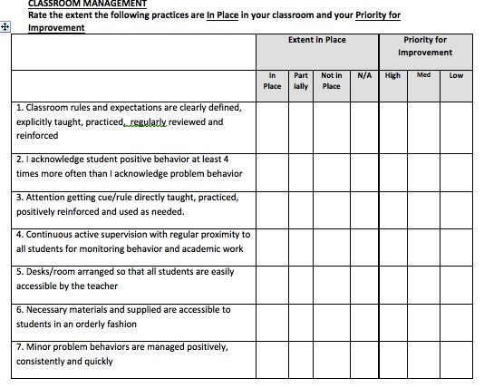
Classroom Management
Self-Assessment
10 minutes
Complete the Classroom Management Self Assessment Checklist
What are your strengths? Areas to develop?
Pick Two Items To Focus on and Set a Goal

Slide 30

Final Questions
maggie.schulze@gmail.com

Slide 31
Acknowledgement
In addition to sources cited throughout, this presentation was created with contributions and materials from:
Bella Bikowsky, Ph.D.
Lisa Hoyt, Ph.D.
Lori Lynass, Ed.D.
Bridget Walker, Ph.D.
Note: All materials and content provided are property of the presenters. All Rights Reserved. Request written permission for use outside your classroom.

